Slide 1
Seasonal flu analysis

Slide 2
Model approach
Following Adam’s previous study (Kucharski and Gog, 2012, PLoS Comp Bio)...
Begin in 1968 for H3N2 and 1977 for H1N1 (year of each subtype’s pandemic emergence).
Simulate forward to 2014 (the last year for which we have data)
Consider each flu season as a discrete epidemic, and use final outbreak size approximations to estimate the fraction of each age group (single-year) that became infected with the circulating strain.
Assume all seasonal strains in the same cluster are immunologically indistinguishable.
Keep track of the fraction of each age group with previous exposure to all possible sets of previously circulating strains, based on the year of interest.
e.g. if 3 clusters of H3N2 have circulated by the 1975 flu season, possible exposure histories would be: {NULL, 1, 2, 3, 12, 13, 23, 123}.
Between seasons, allow individuals to age one year so children are more likely to be naive, and can’t have been exposed to strains that circulated before they were born.

Slide 3
Model Free Parameters
R0
Cross-immunity parameters
A Intercept parameter. Sets the probability of reinfection if cluster i has been encountered previously (i.e. distance between i and j is 0).
α Decay parameter. Sets how fast cross-immunity decays as clusters i and j become farther apart.
Probability of cross immunity against cluster i, given previous exposure to set Y
Decreases exponentially as the challenge cluster (i) becomes farther away from the most similar, previously encountered cluster in set Y.

Slide 4
Model Free Parameters
R0
Cross-immunity parameters
A Intercept parameter. Sets the probability of reinfection if cluster i has been encountered previously (i.e. distance between i and j is 0).
α Decay parameter. Sets how fast cross-immunity decays as clusters i and j become farther apart.
Original antigenic sin parameter
τ Assume that if σ({j}, k) < τ, that OAS prevents the formation of new immunity against cluster k.
Vaccine effectiveness
ν Reduce the fraction of age group a that is naturally susceptible to strain i by the following factor at the beginning of each season: (1-p_{a}ν), where p_{a} is the probability of vaccination at age a

Slide 5
Fitting approach
Use the model to simulate incidence for each influenza season from:
1968-2014 for H3N2
1977-2014 for H1N1
Use a multinomial likelihood to fit the model predicted fraction of cases in each age group to the observed fraction of cases in each age group within the year of interest.
Currently using MLE, optim() in R, because the likelihood for H3N2 takes too long to run MCMC.

Slide 6
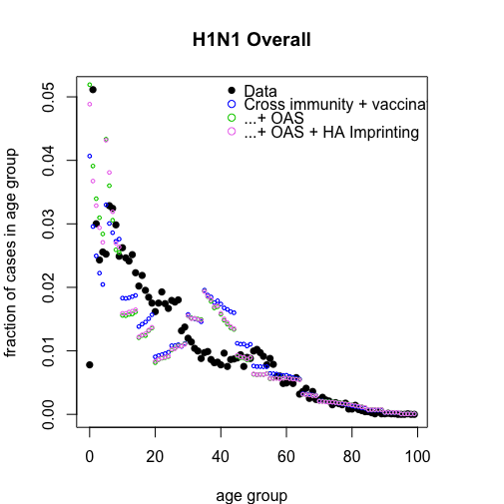
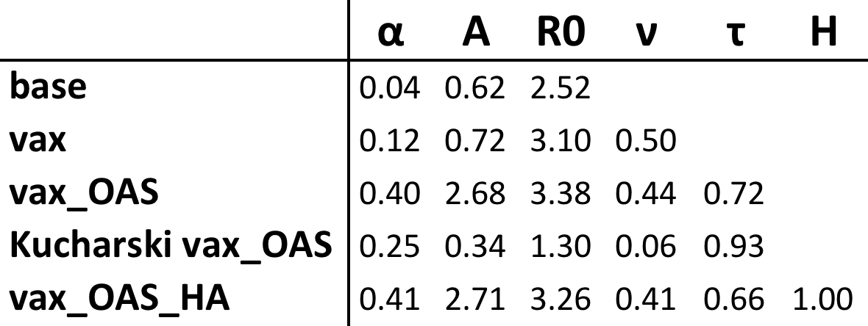
Preliminary results (no HA imprinting)
also see All_model_fits.pdf

Slide 7
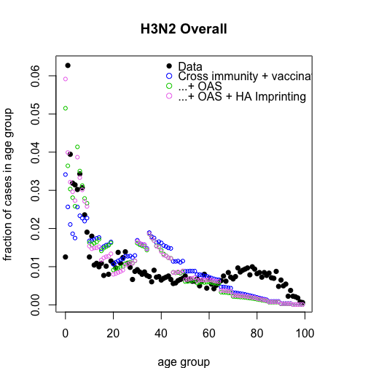
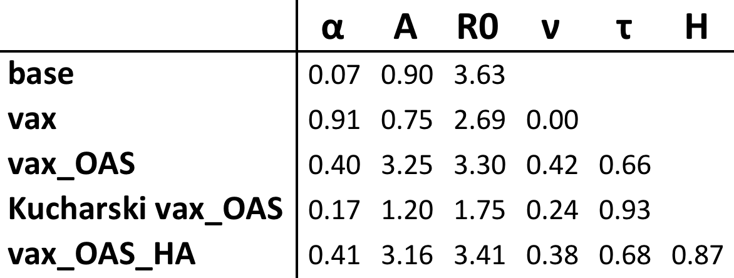
Preliminary results (no HA imprinting)
also see All_model_fits.pdf

Slide 12
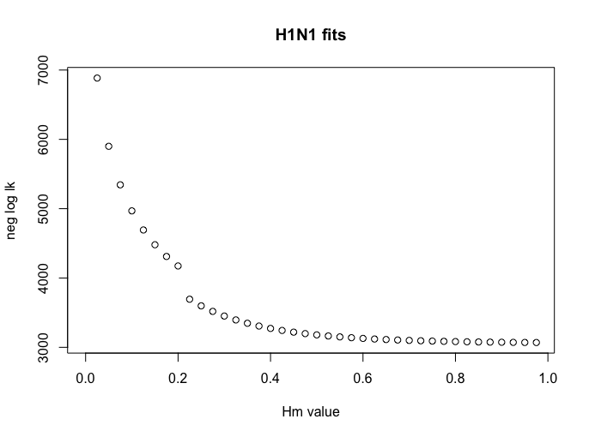
Grid search on Hm, with all other parameters fixed to best estimates in the absence of imprinting

Slide 13
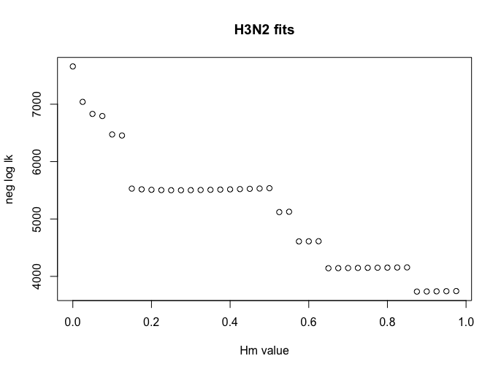
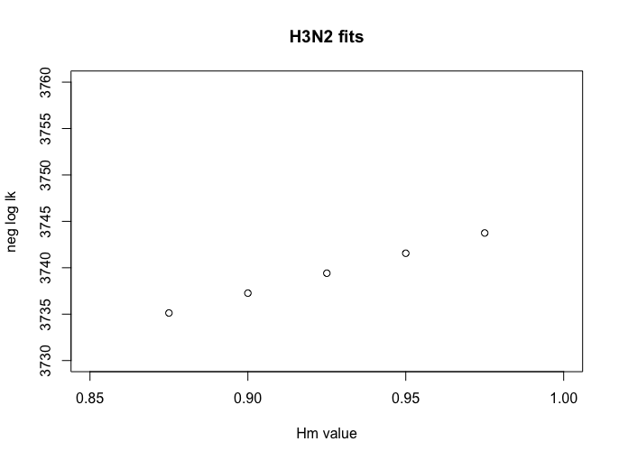
Grid search on Hm, with all other parameters fixed to best estimates in the absence of imprinting

Slide 14
Issues with fitting
Sometimes the optimization algorithm tests a set of parameters where cross-immunity is strong enough that susceptibles are depleted outbreaks don’t occur every year.
Model predicts NO cases in certain years
Multinomial prob. is 0 in all age groups
Likelihood is not defined
To deal with this, I am imposing a moderate likelihood penalty in these cases, but I think this makes the likelihood surface jagged and sometimes causes the optimization to fail

Slide 15
Issues with fitting
Also, when I calculate likelihood profiles on the H parameter (strength of HA imprinting), I can sometimes find likelihood values that are slightly better than the optimum estimate.
Calculating profiles on a very fine H grid shows that the likelihood appears really jagged
rounding errors?
any idea why this could be?
probably means my results are not ready to present?
Can I even trust my AIC estimates?

Slide 16
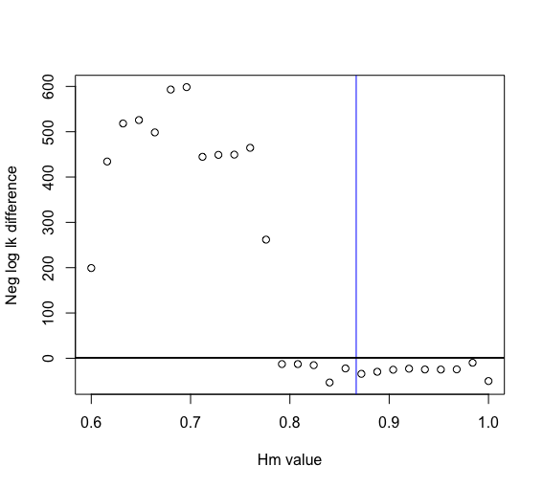
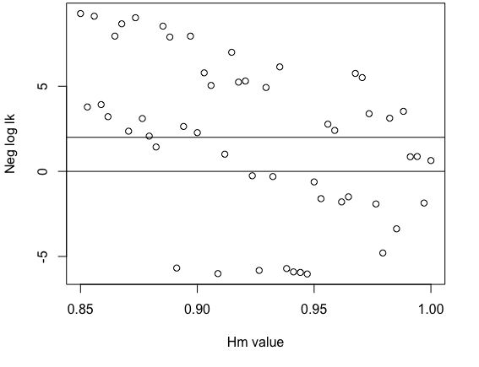
H1 proflies on Hm

Slide 17
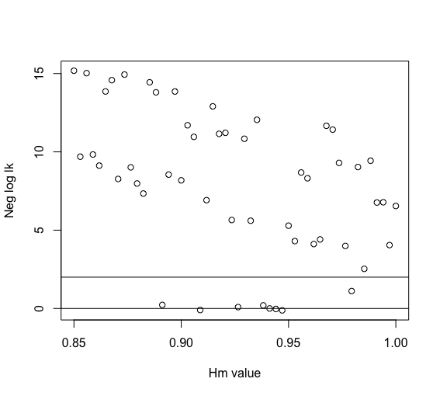
H1 profiles on Hm, if we re-optimize with the best profile values as initial conditions

Slide 18
H3 proflies on Hm

Slide 19
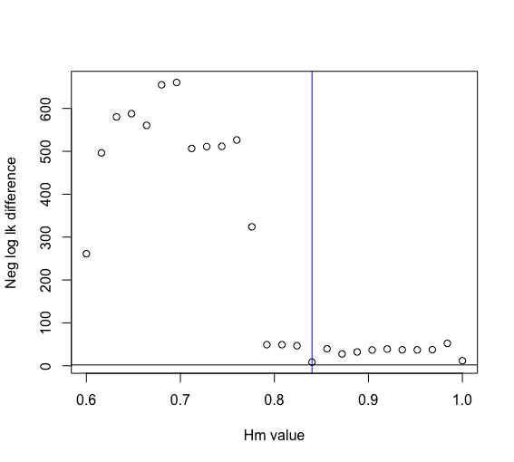
H3 profiles on Hm, if we re-optimize with the best profile values as initial conditions

Slide 20
What can I do in the next two weeks to get this into shape?
Is it ok to present a grid search?

Slide 21
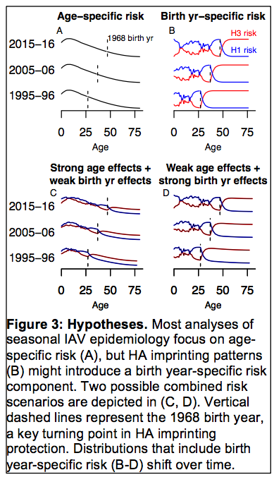
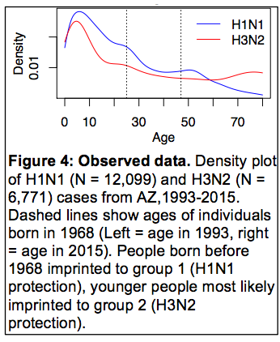
Simple analysis

Slide 22
Simple analysis
A = age specific effects (fit using Adam’s model)
B = birth year specific effects (what fraction of each birth year lacks imprinting protection?)
p = vector of multinomial probabilities that a randomly sampled case falls in a particular age class
p = A*a + B(1-a) -> define p as a linear combination of A and B
-> fit parameter a, the weight placed on age-specific effects
 | aa estimate | bb estimate
H3 | 0.61 | 0.39
H1 | 1 | 0
H1 subtype-specific | 1 | 0

Slide 23
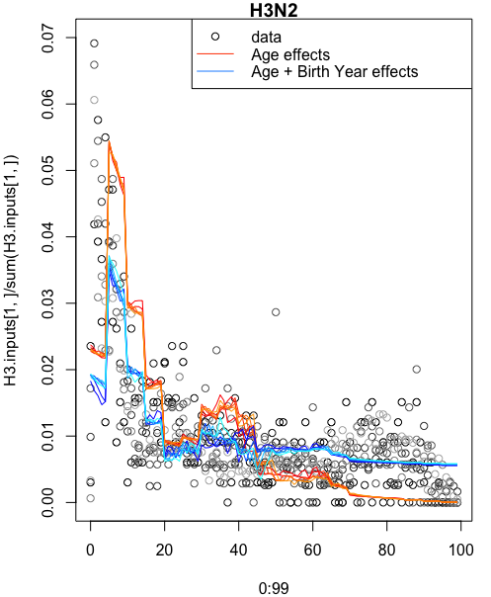
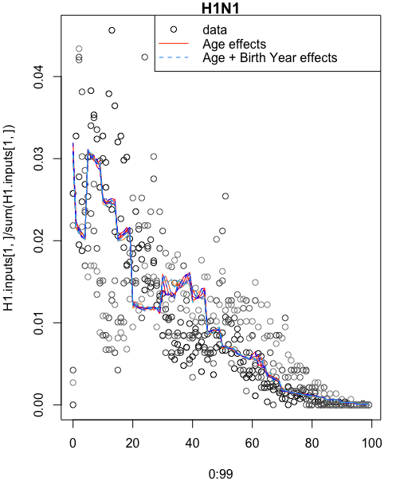
A = age specific effects (fit using Adam’s model)
B = birth year specific effects (what fraction of each birth year lacks imprinting protection?)
p = vector of multinomial probabilities that a randomly sampled case falls in a particular age class
p = A*a + B(1-a) -> define p as a linear combination of A and B
-> fit parameter a, the weight placed on age-specific effects

